Slide 1
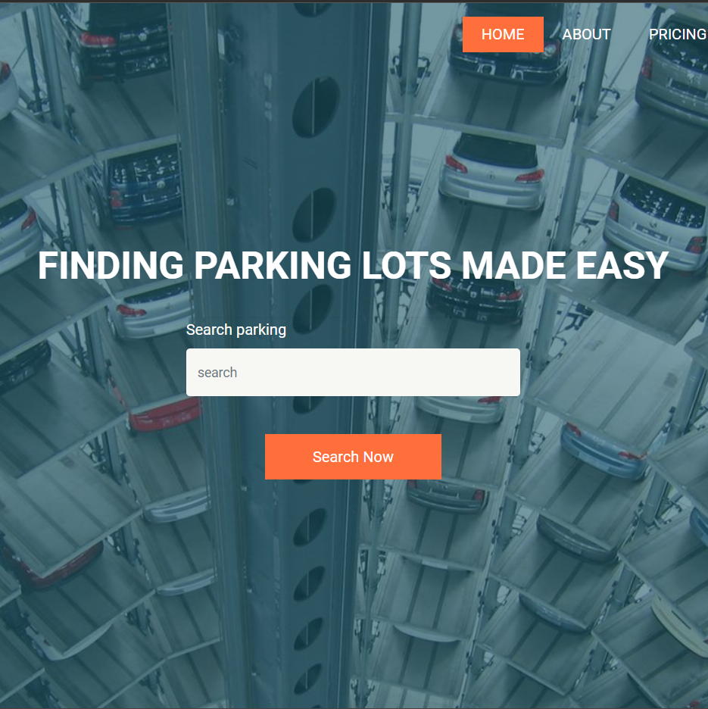
PARKING MANAGEMENT SYSTEM
ALFIN VARGHESE
22PMC108

Slide 2
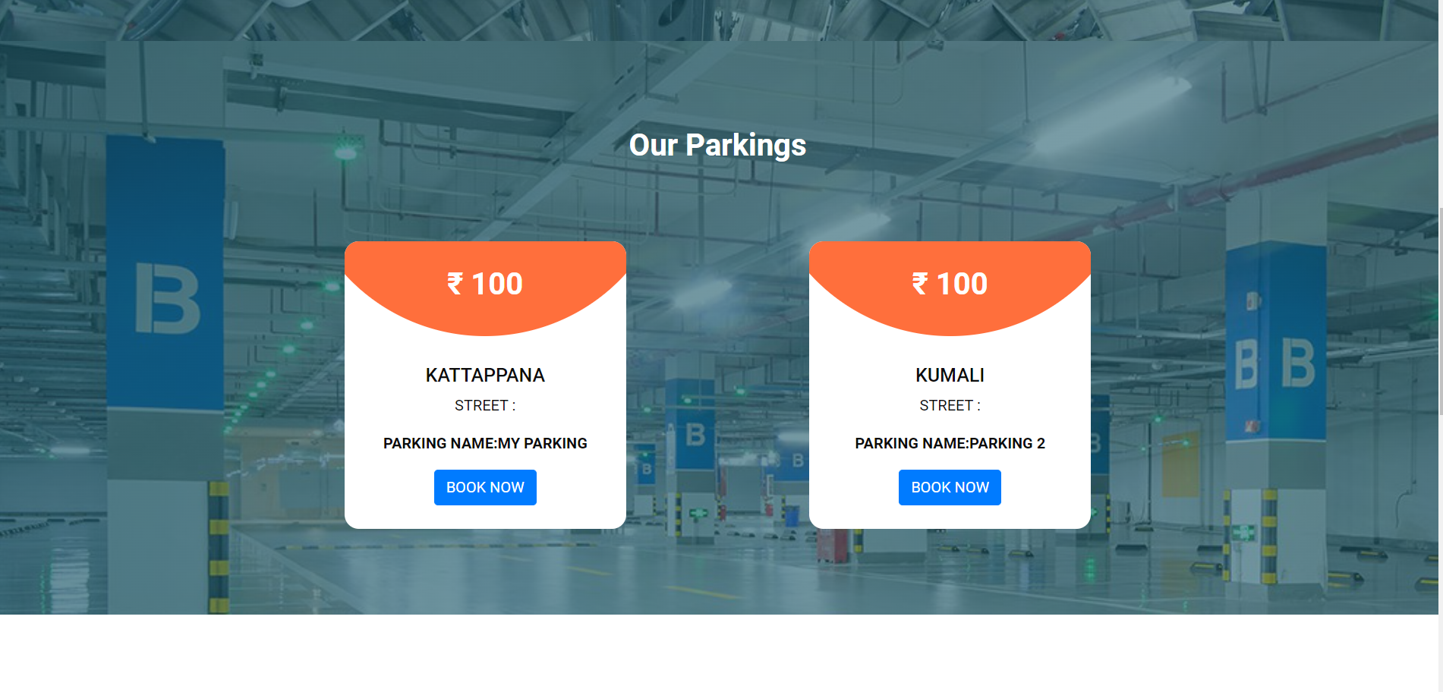
ABSTRACT
The Parking Reservation System is a parking guidance and reservation system in towns. The project contains the admin sides and the user side. The admin can view and manage the users,and manage the parking area.The users are the clients who want to park their vehicles in the parking area. A user has to login first to make the parking pass. If he/she has not registered, they can register first and then login. Then users can book parking slots . Looking for spaces to park can be really hectic in a busy town in regard to walking distance to your destination from your vehicle, safety of the vehicle…etc. If one happens to be a stranger in town it gets more difficult to operate around the town. This project is a very simple project that solves all these parking cycle issues.

Slide 3

Project requirements
1. Register and login for the user.
2. User will be able to give basic details like address, name, vehicle details .
3. The admin can add vehicle ,mange vehicles in and out.
4.Parking Reservation page
5.Payment portal
6. The admin can view and manage the users, manage the parking .
7.The admin can view vehicles between the dates
8.In admin page where there will be notification of the parking requests.
9.Admin can view reports.

Slide 4
FEATURES AND HIGHLIGHTS
1.Users can register and login into the system.
2.Users can search parking places.
3.Users can view different parking locations.
4.Users can add vehicles .
5.In user home page user can edit and view vehicles details.
6.User can take print of booking details.
7.User can book parking slots for their vehicle.
8.If we click book now in slot ,book now will changes to booked state.
9.The available slots number will reduce when booking slots.

Slide 5
FEATURES AND HIGHLIGHTS
10.The Admin can view
1.Todays vehicle entries
2.Yesterdays vehicle entries
3.Last 7 days vehicle entries
4.Total vehicle entries
11.Admin can add Vehicle Category.
12.Admin can edit Vehicle category.
13.Admin can Manage IN and OUT Vehicles.
14.Admin will get between dates report.

Slide 6
Technical aspects
Presentation Layer:
User Interface (UI): This layer includes the components that interact with users, such as web pages or mobile app screens.
Django Templates: Django's built-in template engine allows you to define HTML templates that render dynamic content and interact with the back-end.
Application Layer:
Django: Django serves as the back-end framework, handling HTTP requests, routing, and managing the application's business logic.
Django Views: Views receive requests from the user interface, process data, and generate appropriate responses. They interact with models, services, and external APIs as needed.
Django Forms: Forms handle user input validation and data submission, allowing users to input and update travel-related information.
Third-Party APIs: Integrate with external services such as package booking APIs, to retrieve travel-related information or make bookings

Slide 7
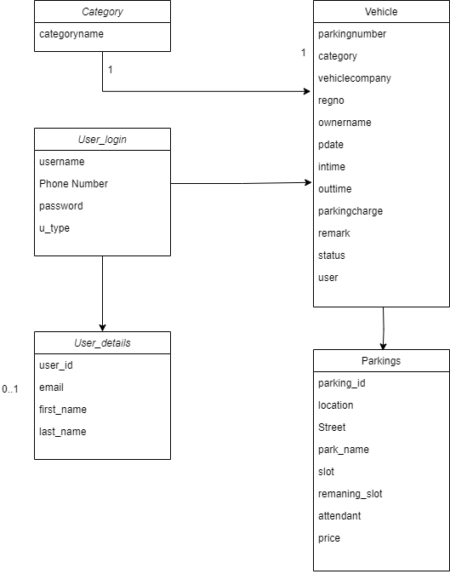
Database class diagram

Slide 8
Challenges faced during the development
User Authentication and Authorization: Implementing a secure and reliable user authentication and authorization system can be challenging. You need to ensure that only authenticated and authorized users can access and perform actions within the reservation system.
Database Design and Management: Designing an efficient and scalable database structure for storing parking-related information can be complex. Plan the database schema carefully, considering factors such as user data, parking lot information, reservations, and availability. Use appropriate indexing and caching techniques to optimize database performance.
Reservation Conflict Resolution: Managing conflicts when multiple users try to reserve the same parking spot simultaneously can be tricky. Implement a mechanism to handle conflicts and ensure that only one user can reserve a spot at a given time. Techniques like optimistic locking or using timestamps can help in resolving conflicts.

Slide 9
Challenges faced during the development
Payment Integration: Integrating payment gateways or implementing a secure and reliable payment system can be challenging. Ensuring secure transactions, handling different payment methods, and managing refunds and cancellations require careful implementation and adherence to security standards.
User Experience and User Interface: Designing an intuitive and user-friendly interface for making reservations can be a challenge. Conduct user research, gather feedback, and iterate on the user interface to provide a smooth and hassle-free experience for users. Focus on usability, responsiveness, and accessibility considerations.
Testing and Quality Assurance: Thoroughly testing the parking reservation system to identify and fix bugs, as well as ensuring its reliability, can be a significant challenge. Implementing unit tests, integration tests, and conducting usability testing can help ensure the system functions as expected and meets user requirements.

Slide 10

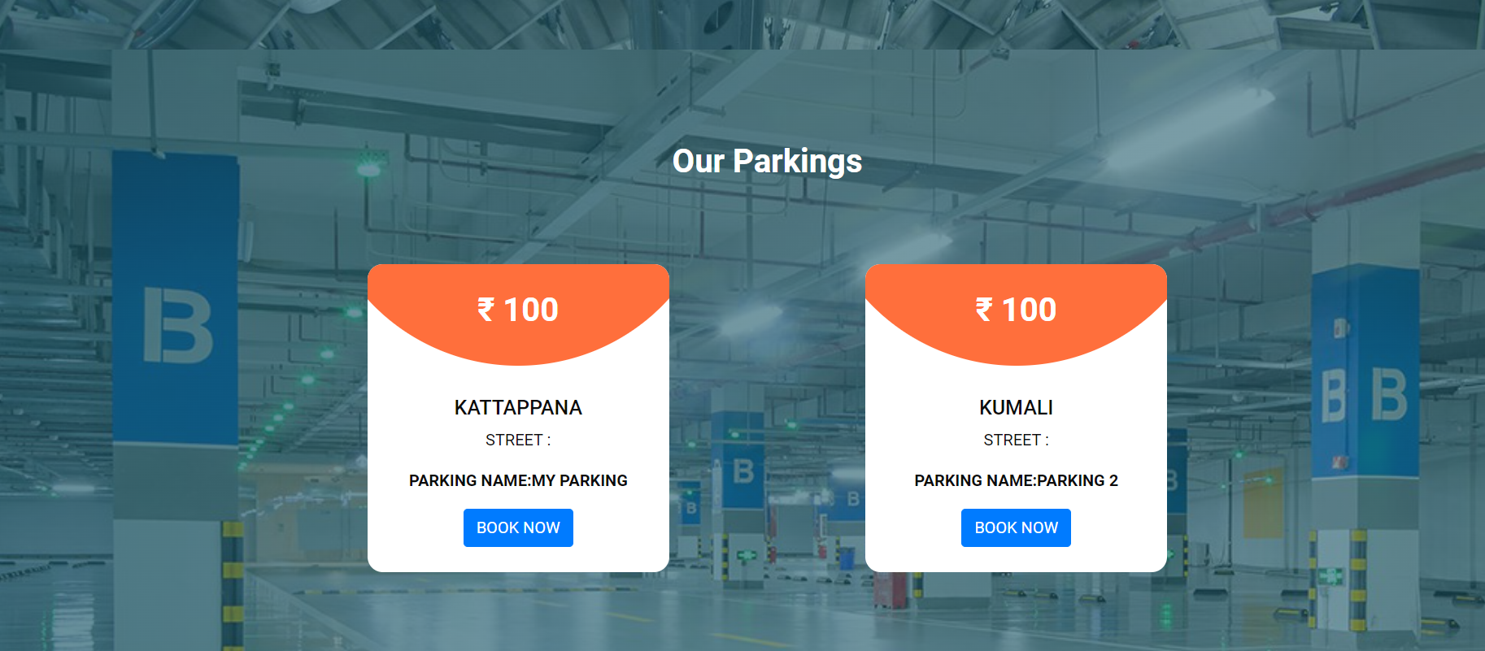
Important Screenshots with explanation
INDEX PAGE
User can search and view parking locations

Slide 11
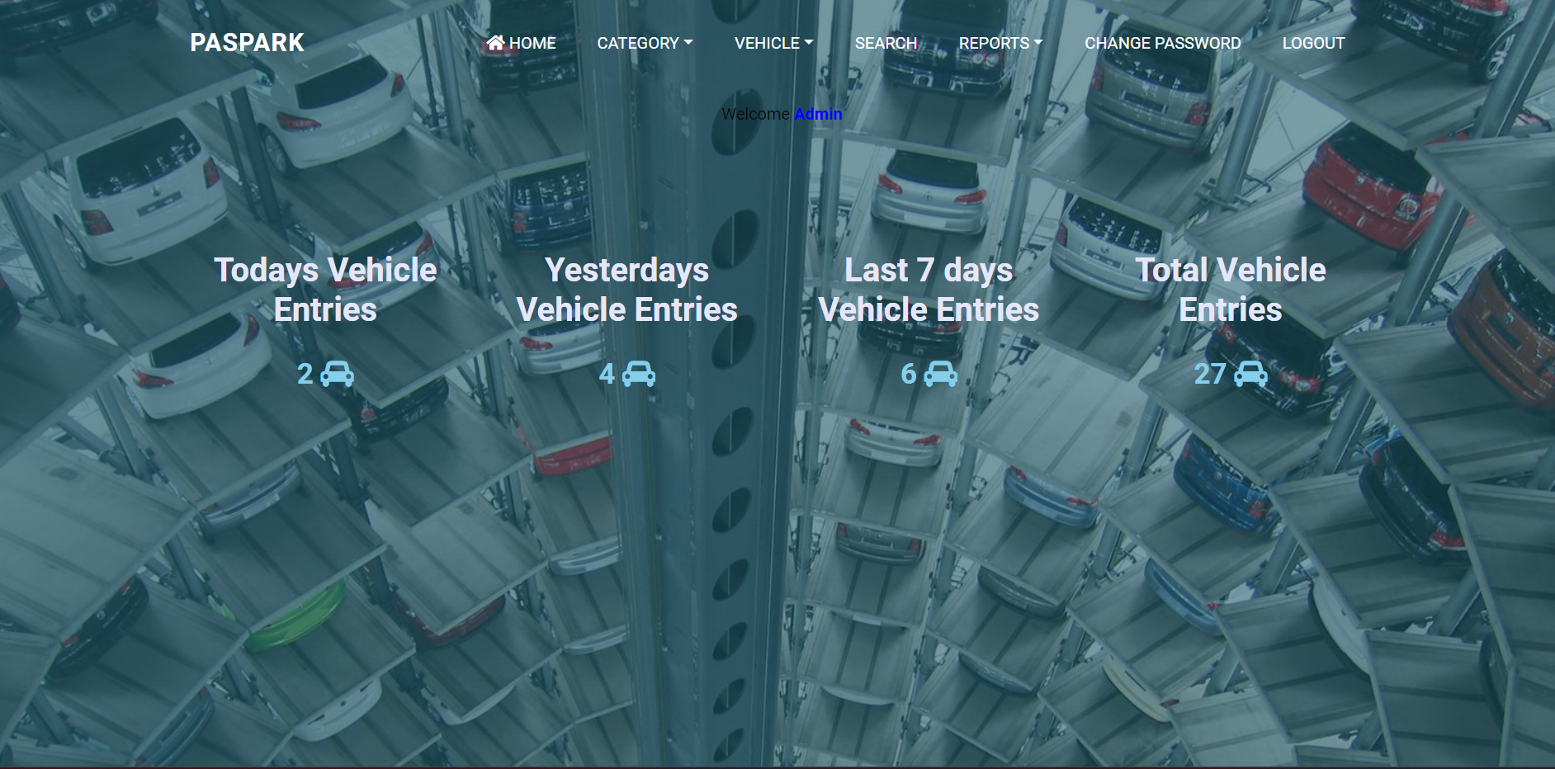
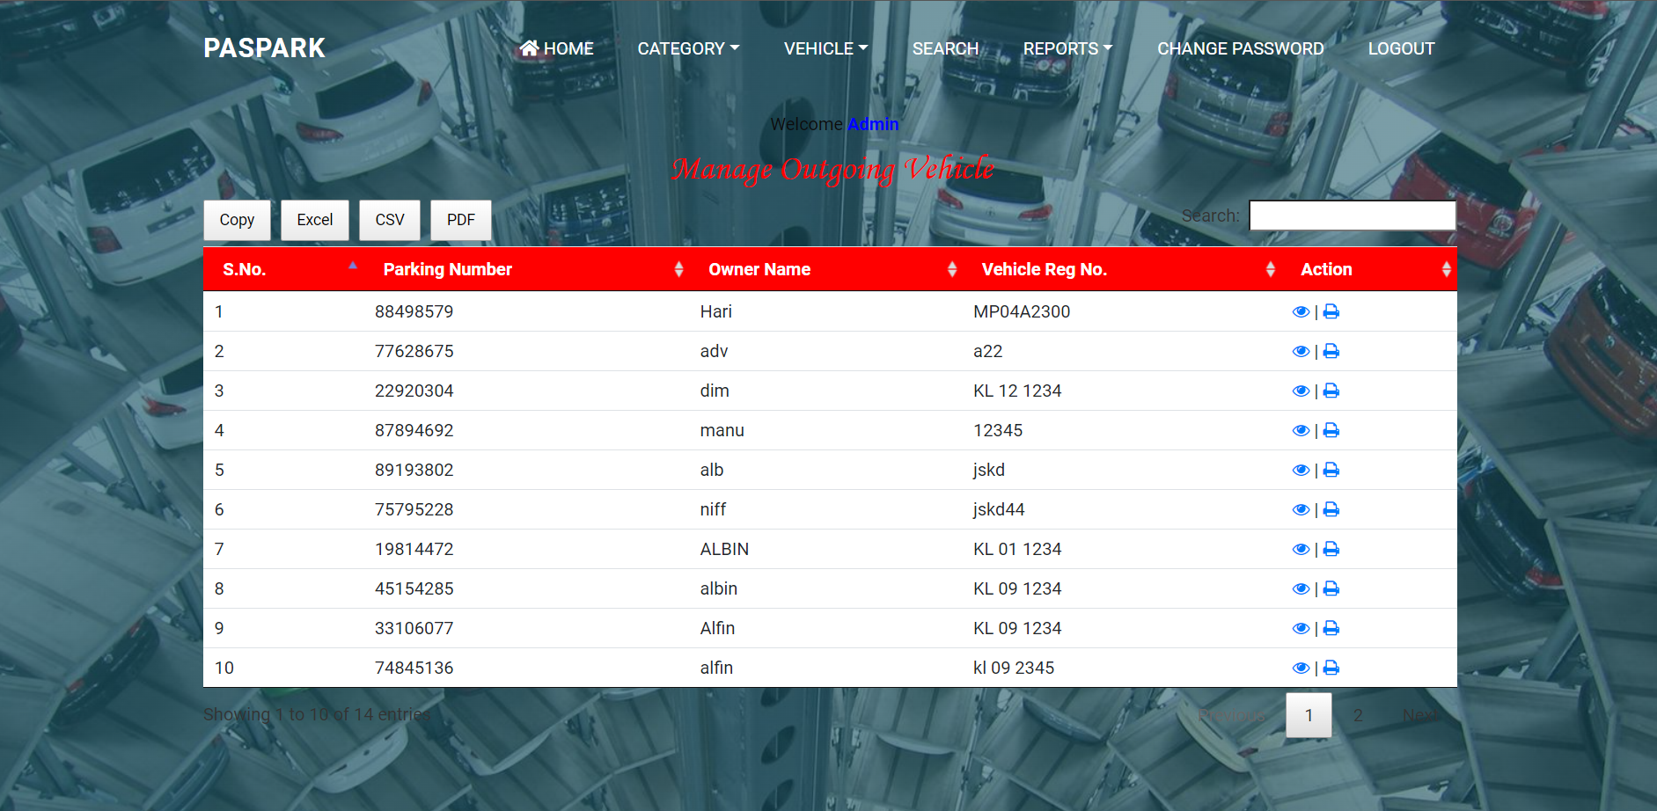
Important Screenshots with explanation
MANAGE OUT GOING VEHICLE
Admin can view the details of outgoing vehicles
ADMIN HOME PAGE
Admin can view number of vehicle Entered today, Yesterday ,last 7 days and Total entries information's.

Slide 12
Future enhancements
Mobile Application: Develop a mobile application for the parking reservation system to allow users to easily book parking spaces, receive notifications, and manage their reservations on their mobile devices.
Real-Time Availability: Implement real-time availability updates to provide users with up-to-date information on parking space availability.
Advanced Booking Options: Add advanced booking options such as hourly, daily, weekly, or monthly bookings to accommodate different user needs and preferences.
Loyalty and Rewards Program: Implement a loyalty program to reward frequent users with points, discounts, or exclusive benefits. This can encourage customer retention and increase user engagement.
Pre-Booking and Pre-Payment: Allow users to pre-book and pre-pay for parking spaces in advance, reducing waiting times and providing a seamless parking experience.
Integration with Cashless Payment Systems: Integrate the parking reservation system with cashless payment systems, such as mobile wallets or contactless payment methods, to offer convenient and secure payment options for users.
Analytics and Reporting: Implement analytics and reporting features to provide insights into parking space utilization, popular time slots, revenue generation, and other key metrics.

Slide 13
Conclusion
The project was successfully completed within the time span allotted. All the modules are tested separately and put together to form the main system. Finally, the modules are tested with real data and it worked successfully. Thus the system has fulfilled the entire objective defined. Our goal of developing this project Parking Reservation System has come to a good result without many defects. Online vehicle parking reservation system improves the existing system since we are in computerized world. With this new system is mandatory, it enables the user of the system (client, employee, System administrator) to reserve a parking lot online and this reduces the wasting of time of the clients looking for where to park, increase the safety of the property since the parking lot is numbering. So this system provides all the available best services to all the customers

Slide 14
References
https://parclick.com/
https://planyo-extras.s3.amazonaws.com/website/parking/parking.html

Slide 15
Thank you

